Slide 1


Protractor
as e2e testing framework for JS

Slide 2

PROTRACTOR
Protractor is an end-to-end test framework for Angular and AngularJS applications. Protractor runs tests against your application running in a real browser, interacting with it as a user would.
Protractor supports Angular-specific locator strategies, which allows you to test Angular-specific elements without any setup effort on your part.

Slide 3
OVERVIEW
1
Protractor is an end-to-end test framework for AngularJS applications.
2
Protractor runs tests against your app running in a real browser, interacting with it as a user would.
3
Protractor is built on top of WebDriverJS, which uses native events and browser-specific drivers to interact with your application as a user would.
4
It also supports non-angular APP.
5
With protractor, you can write e2e tests with JavaScript, the language you write with Angular app.
6
Protractor works in conjunction with Selenium to provide an automated test infrastructure that can simulate a user’s interaction with an Angular application running in a browser or mobile device.
7
It has Angular-specific features.
8
It's element finders wait for Angular's $digest loop and $http to finish. So you'll have less chance to struggle with sleep and timing issues.

Slide 4
BUILT IN OPTIONS
1
Run test framework with CLI and configuration file
2
Integration with more popular JavaScript test framework - Jasmine, Mocha, Cucumber
3
Maintains a queue of pending promises to keep execution organized
4
Provides Api to locate and perform actions on DOM elements
5
Provides synchronization with Angular application

Slide 5

SYNCHRONIZATION WITH ANGULAR
Because WebDriver tests are asynchronous and involve many components, there are several reasons why a timeout could occur in a Protractor test.
Waiting for Page to Load - When navigating to a new page using browser.get, Protractor waits for the page to be loaded and the new URL to appear before continuing.
Looks like: an error in your test results - Error: Timed out waiting for page to load after 10000ms
Default timeout: 10 seconds
How to change: To change globally, add getPageTimeout: timeout_in_millis to your Protractor configuration file. For an individual call to get, pass an additional parameter: browser.get(address, timeout_in_millis)

Slide 6
SYNCHRONIZATION WITH ANGULAR
Waiting for Angular - Before performing any action, Protractor waits until there are no pending asynchronous tasks in your Angular application. This means that all timeouts and http requests are finished.
Looks like: an error in your test results - Timed out waiting for asynchronous Angular tasks to finish after 11 seconds.
Default timeout: 11 seconds
How to change: Add allScriptsTimeout: timeout_in_millis to your Protractor configuration file.
You may also need to fix this problem with a change to your application.

Slide 7
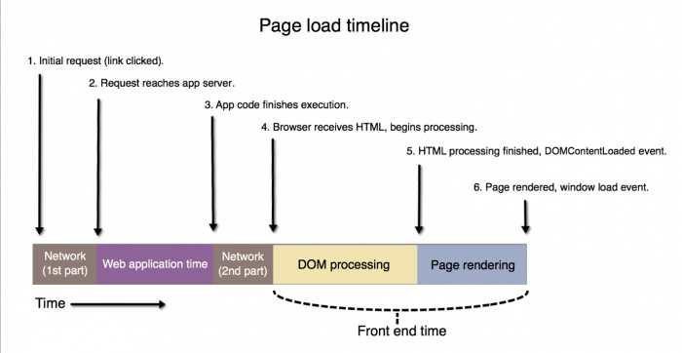
SYNCHRONIZATION WITH ANGULAR
Waiting for Angular on Page load - Protractor waits for the angular variable to be present when loading a new page.
Looks like: an error in your test results - Angular could not be found on the page: retries looking for angular exceeded
Default timeout: 10 seconds
How to change: To change globally, add getPageTimeout: timeout_in_millis to your Protractor configuration file. For an individual call to get, pass an additional parameter: browser.get(address, timeout_in_millis)

Slide 8
SYNCHRONIZATION WITH ANGULAR
If your AngularJS application continuously polls $timeout or $http, Protractor will wait indefinitely and time out. You should use the $interval for anything that polls continuously (introduced in Angular 1.2rc3).
Angular
For Angular apps, Protractor will wait until the Angular Zone stabilizes. This means long running async operations will block your test from continuing. To work around this, run these tasks outside the Angular zone. For example:
Browser
this.ngZone.runOutsideAngular(() => {
setTimeout(() => {
// Changes here will not propagate into your view.
this.ngZone.run(() => {
// Run inside the ngZone to trigger change detection.
});
}, REALLY_LONG_DELAY);
});
Driver
Page
WD request
Sync
http pending requests
Angular
WD response

Slide 9
non-AngularJS app
You only need to access the webdriver instance by using browser.driver:
browser.driver.findElement(by.css('[data-ptor="submit-btn"]'));
/** * If true, Protractor will not attempt to synchronize with the page before * performing actions. This can be harmful because Protractor will not wait * until $timeouts and $http calls have been processed, which can cause * tests to become flaky. This should be used only when necessary, such as * when a page continuously polls an API using $timeout. */
browser. waitForAngularEnabled (true);

Slide 10
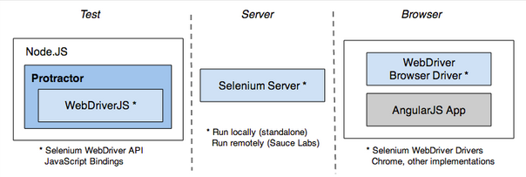
HOW IT WORKS
Protractor works in conjunction with Selenium to provide an automated test infrastructure that can simulate a user’s interaction with an Angular application running in a browser or mobile device.
When working with Protractor, it’s important to keep the following in mind:
Protractor is a wrapper around WebDriverJS, the JavaScript bindings for the Selenium WebDriver API (before writing any tests, skim through the WebDriverJS Users Guide).
WebDriver commands are asynchronus. They are scheduled on a control flow and return promises, not primitive values (see The WebDriver Control Flow).
Your test scripts send commands to the Selenium Server, which in turn communicates with the browser driver.

Slide 11
INSTALLING
Protractor is a Node.js program. To run Protractor, you will need to have Node.js installed. You can use to npm package to install Protractor.
npm install -g protractor webdriver-manager update webdriver-manager start
The Protractor install includes the following:
protractor command line tool
webdriver-manager command line tool
Protractor API (library)
Protractor needs two files to run, the test or spec file, and the configuration file. Protractor tests are written using the syntax of your test framework, for example Jasmine, and the Protractor API.
The configuration file tells Protractor how to set up the Selenium Server, which tests to run, how to set up the browsers, and which test framework to use. The configuration file can also include one or more global settings.

Slide 12
Setup a conf.js file
More config options
How to run:
exports.config = { seleniumAddress: 'http://localhost:4444/wd/hub', capabilities: { 'browserName': 'chrome' }, specs: ['example-spec.js'], jasmineNodeOpts: { showColors: true } };
webdriver-manager start protractor test/e2e/config.js // this is the relative path to your config.js file
Find guide for setting up framework with protractor here
Notes:
https://github.com/angular/protractor/blob/master/lib/config.ts

Slide 13
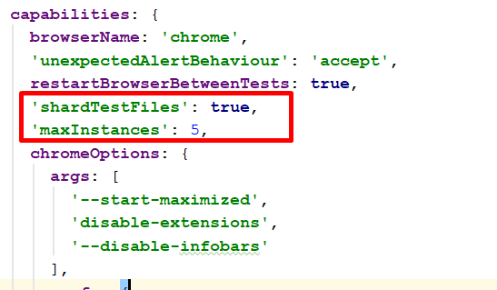
SEVERAL FLOWS
exports.config = { seleniumAddress: 'http://localhost:4444/wd/hub', multiCapabilities: [ { 'browserName': 'chrome' }, { 'browserName': 'firefox' } ], specs: ['example-spec.js'], jasmineNodeOpts: { showColors: true } };
Protractor can launch your tests on one or more browsers. If you are testing on a single browser, use the capabilities option.
If you are testing on multiple browsers, use the multiCapabilities array.
In addition, you may specify count, shardTestFiles, and maxInstances.

Slide 14
BASIC EXAMPLE
// conf.js exports.config = { framework: 'jasmine', seleniumAddress: 'http://localhost:4444/wd/hub', specs: ['spec.js'] }
// spec.js describe('Protractor Demo App', function () { it('should have a title', function () { browser.get('http://juliemr.github.io/protractor-demo/'); expect(browser.getTitle()).toEqual('Super Calculator'); }); });
protractor conf.js

Slide 15
API – Browser
browser - A wrapper around an instance of WebDriver, used for navigation and page-wide information
/**
* Create a new instance of Protractor by wrapping a webdriver instance.
*
* @param {webdriver.WebDriver} webdriver The configured webdriver instance.
* @param {string=} opt_baseUrl A URL to prepend to relative gets.
* @param {boolean=} opt_untrackOutstandingTimeouts Whether Protractor should stop tracking outstanding $timeouts.
* @return {Protractor}
*/
exports.wrapDriver = function(webdriver, opt_baseUrl, opt_rootElement, opt_untrackOutstandingTimeouts) {
return new Protractor(webdriver, opt_baseUrl, opt_rootElement, opt_untrackOutstandingTimeouts);
};

Slide 16
API – Element
element - A helper for finding and interacting with DOM elements on the page you are testing that provides two classes:
ElementFinder - a wrapper around webdriver.WebElement, you may perform actions (i.e. click, getText) on them as you would a WebElement. Unlike a WebElement, an ElementFinder will wait for angular to settle before performing findings or actions.
ElementArrayFinder - is used for operations on an array of ElementFinder (as opposed to a single element).

Slide 17
API - BY
element(by.id('user_name')) //Locates an element by its ID. element(by.css('#myItem')) //Locates elements using a CSS selector.
element(by.model('person.name')) // Find an element by ng-model expression.
element(by.binding('person.concatName')); // Find an element by text binding. element(by.buttonText('Save')); //Find a button by text. element(by.partialButtonText('Save')); //Find a button by partial text.
element(by.linkText('Save')); //Locates link elements whose visible text matches the given string. element(by.partialLinkText('Save')); //Locates link elements whose visible text contains the given substring. element(by.cssContainingText('.pet', 'Dog')); //Find elements by CSS which contain a certain string.
element.all(by.options('c c in colors')); //Find an element by ng-options expression.
element.all(by.repeater('book in library')); //Find elements inside an ng-repeat.
element(by.xpath('//ul/li/a')) //Locates elements matching a XPath selector.
Full list of available methods
Notes:
http://www.protractortest.org/#/api

Slide 18
API – Protractor
protractor - The Protractor namespace which wraps the WebDriver namespace. Contains static variables and classes, such as:
protractor.Key - enumerates the codes for special keyboard signals.
protractor.ExpectedConditions - represents a library of expected conditions that are useful for protractor, especially when dealing with non-angular apps.
Notes:
http://www.protractortest.org/#/api

Slide 19
JavaScript in AT: Protractor pros and cons
Support by Angular community
High Level abstraction (built-in factories, builders, workers etc, configuration through config file)
Supports JS test frameworks (mocha, jasmine, cucumber)
Improved Control Flow (Promises chaining)
Integration with CI (Bamboo Atlassian, Jenkins, Teamcity etc.)
Tests quite slow
Build in Solutions make you dependent
Easy make simple solution build-in for integration tests
You have to create complex solution if create tests as user do

Slide 20
Thanks for attention

